Slide 1
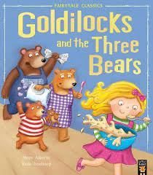
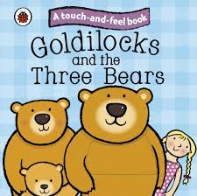
Activities to do at Home linked to Goldilocks and the Three Bears
This is the book we are covering in nursery at the moment.
Perhaps take a trip to the local library in Luton town centre and see if you can find a copy of the story to share. The library is free to join and you can also borrow books for free returning them to borrow new ones. There is only a charge if you are late returning the books or they are purposefully damaged.

Slide 2
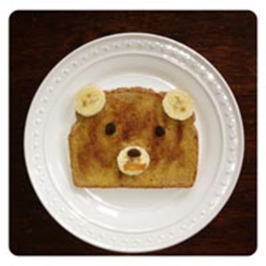
Bear Snack
What you will need:
Bread
Banana
Raisins or Chocolate
Butter
Sugar
Cinnamon (optional)
What you do:
Mix sugar with cinnamon (if using). Toast bread lightly. Spread with butter while hot. Sprinkle with cinnamon sugar mixture. Slice banana and use one slice for the bear's nose. Place raisins or chocolate for the eyes and one for the black nose. Finish the bear with two banana slices for the ears. Enjoy!

Slide 3
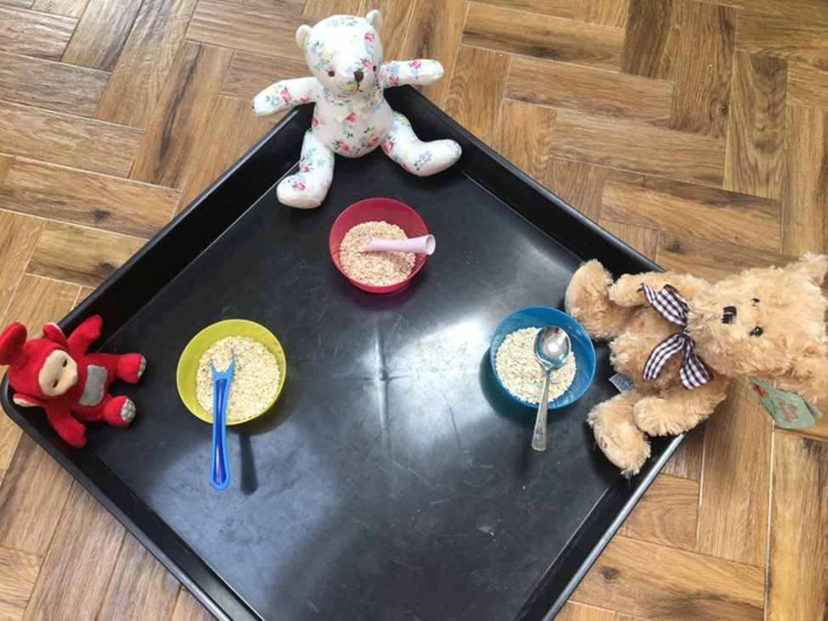
Goldilocks and the Three Bears – Yummy Porridge
Using the classic story as inspiration, this is a great activity to start exploring the world of imaginative play by feeding the bears their porridge. For older toddlers there are also links to Maths by using different sized bears, spoons and bowls.
How to set up:
Using what you have in the kitchen cupboards and a toy bag, place porridge oats into three bowls and used three different sized spoons and teddies to represent the bears from the story.
You can also use the teddies and a puppet of Goldilocks to tell the story to your child.
To make this activity messier, you could make porridge by adding a jug of milk

Slide 4
Nursery Rhymes – Links
Have fun singing and dancing with your child by exploring the following links. Click on the links below to find the songs on YouTube
Goldilocks and the three bears – Fairy tale Nursery Rhyme by Baby Hazel
https://www.youtube.com/watch?v=c1iy8hXbi88
Goldilocks and the Three Bears – Read Aloud Children’s Book
https://www.youtube.com/watch?v=c1iy8hXbi88
Ten in the Bed
https://www.youtube.com/watch?v=5murRlhUYEI

Slide 5
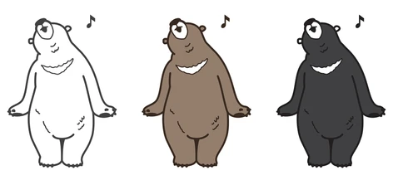
Sing a Song – Teddy Bear, Teddy Bear
The Bear
Original Author Unknown
Here is a cave, (Ball up hand into a fist.)
Inside is a bear. (Put thumb inside fist.)
Now he comes out to get some fresh air. (Pop thumb out of fist.)
He stays all summer In sunshine and heat.
He hunts in the forest for berries to eat. (Move thumb in circle.)
When snow starts to fall,
He hurries inside His warm little cave,
and there he will hide. (Put thumb back inside fist.)
Snow covers the cave
Like a fluffy white rug.
Inside the bear sleeps all cosy and snug. (Cover fist with other hand.)
Teddy Bear, Teddy Bear
Original Author Unknown
Teddy bear, teddy bear, turn around
Teddy bear, teddy bear, touch the ground
Teddy bear, teddy bear, reach up high
Teddy bear, teddy bear, touch the sky
Teddy bear, teddy bear, bend down low
Teddy bear, teddy bear, touch your toes
Teddy bear, teddy bear, go upstairs
Teddy bear, teddy bear, say your prayers
Teddy bear, teddy bear, turn out the light
Teddy bear, teddy bear, say goodnight
Encourage your child to make the movements to the rhyme with their teddy bears.

Slide 6
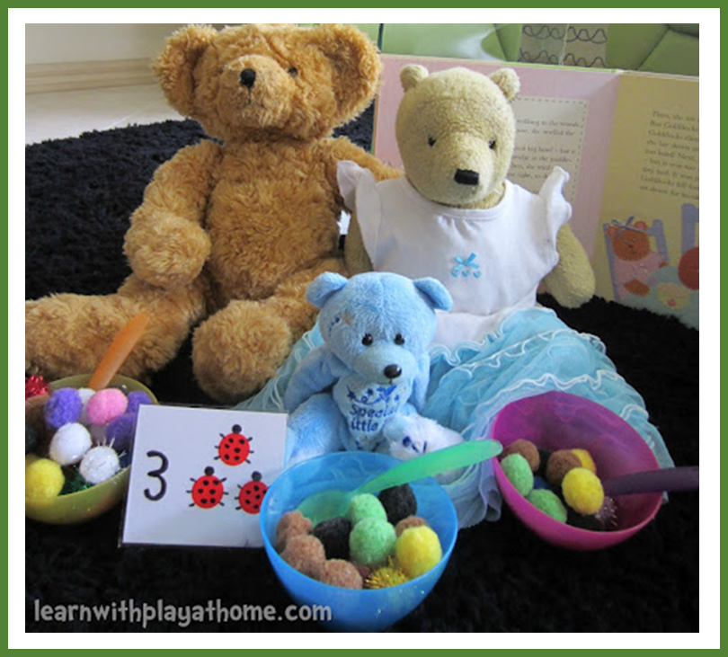
Goldilocks and the Three Bears – Counting Game
This activity will help children to model basic numbers and use counting and grouping strategies to demonstrate and verbalise relationships between basic numbers. In this case, the numbers 1-3.
Materials:
Book/s of Goldilocks and The Three Bears, 3 teddy bears or other toys if you don’t have bears,
Materials for props such as bowls, chairs and beds (eg. Cardboard boxes, plastic containers, sticky tape, playdough, kitchen items, material etc)
How many Bears are there? How many bowls will you need?
Encourage the children to point to each Bear/toy as they count.
See if your child can problem solve and work out how many bowls, cups and spoons are needed. Encourage role play and letting them get involved in the game.
Every focus of the activity does not have to be counting. Enjoy spending time working their hand-eye coordination to fill each of the bowls with "pom pom porridge“
Challenge your child to find and correspond the right sized container to make a bed for each bear. Use this time to talk about Small, Medium and Large. You could encourge them to help make their own bed.
To enhance the learning and add number recognition skills, Put a pile of number cards out on the table and had her find the card that matched the amount of bears.

Slide 7
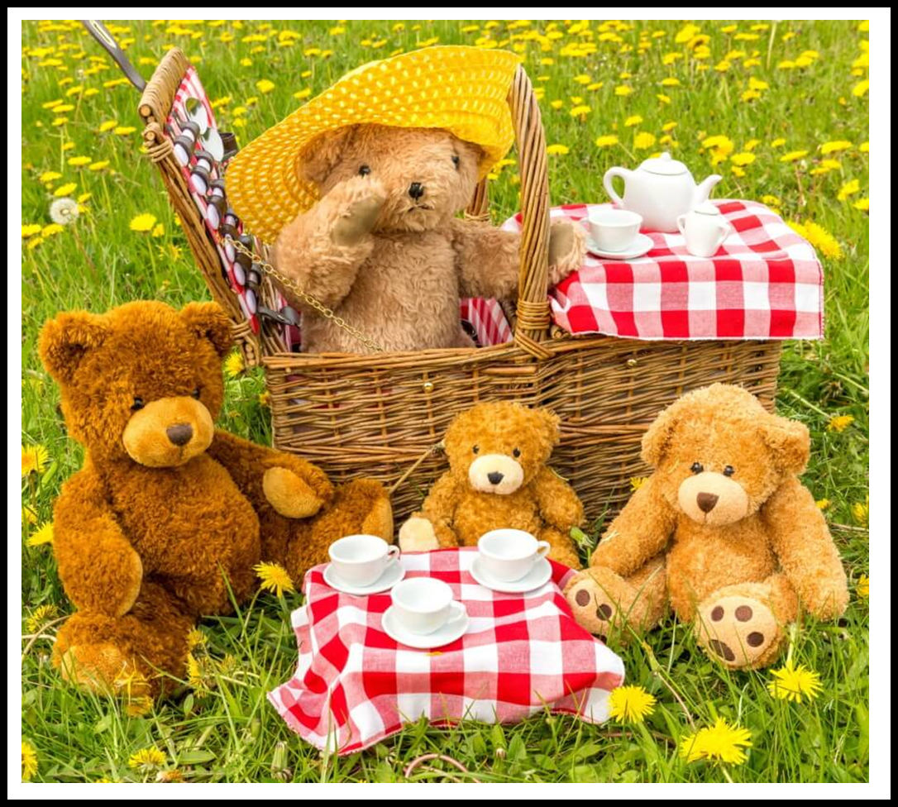
Take your Bear to the Park day
Plan a special day in with their favorite stuffed bears. Go for a walk in the woods with your bears or in the park. What do you and your bear see, what do you and your bear hear? Let your child prepare a special meal to eat with their bears and have a teddy bear picnic outside or inside. Collect some natural things in the park to bring home and make a picture with. If you go to Wardown park you could also play on the swings, feed the ducks and visit the museum. If you go to Stockwood park you could also visit the discovery center and the go to the children’s park.
Learning about Bears -Bear Facts
Go to the library and see if you can find a book on bears. Find out some bear facts. Here are a few to get you started.
Bears are large, heavyset mammals with fur and very short tails. Bears vary in size and colors. Bears are very strong. Baby bears are called cubs. Bear homes are called dens. Bears are omnivores. They eat animals and plants. Their favorite food: berries, honey, fish, leaves, nuts, rodents, insects, and frogs.

Slide 8
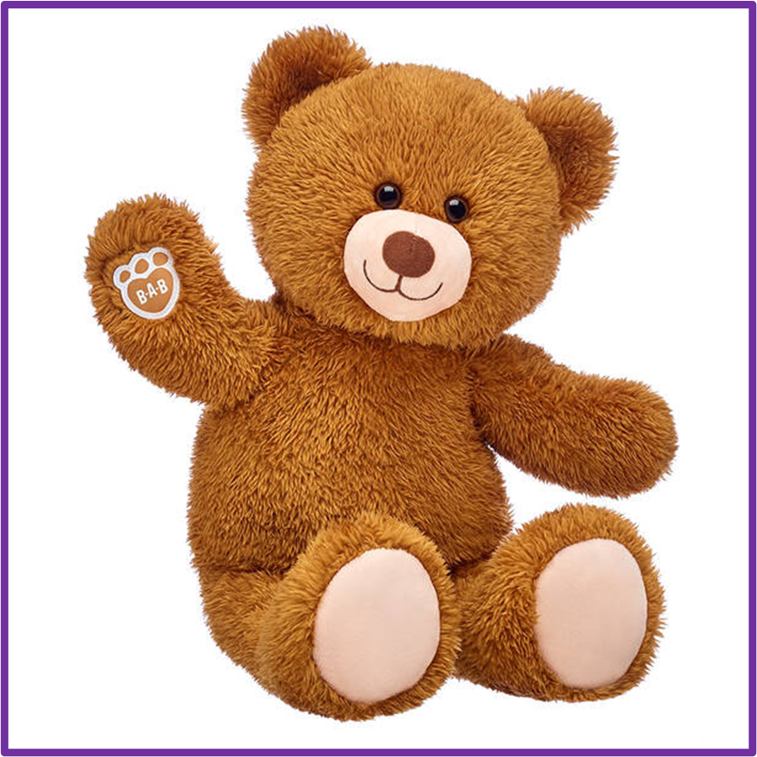
Bear Activities
Bear Artwork
Make a bear. Provide your child with resources to have a go at making a bear. Don’t worry if it doesn’t look like one at the end. Use vocabulary with them as they create. For example How many eyes des it need, does your bear have legs, etc.
You can use natural materials like leaves and twigs to make it or cut up food, draw in flour in a tray or use pens and paper, or an idea of your own.
Make a Bear Cave
Transform a table into a bear by covering it with a brown blanket or sheet. Provide food items for the bear to bring in their cave to eat during the cold winter months.
Bear Walk
Demonstrate ambling by placing your hands flat on the floor with your knees relatively straight. Move your right arm and right leg forward at the same time. Then move your left arm and left leg forward. Repeat movements.

Slide 9
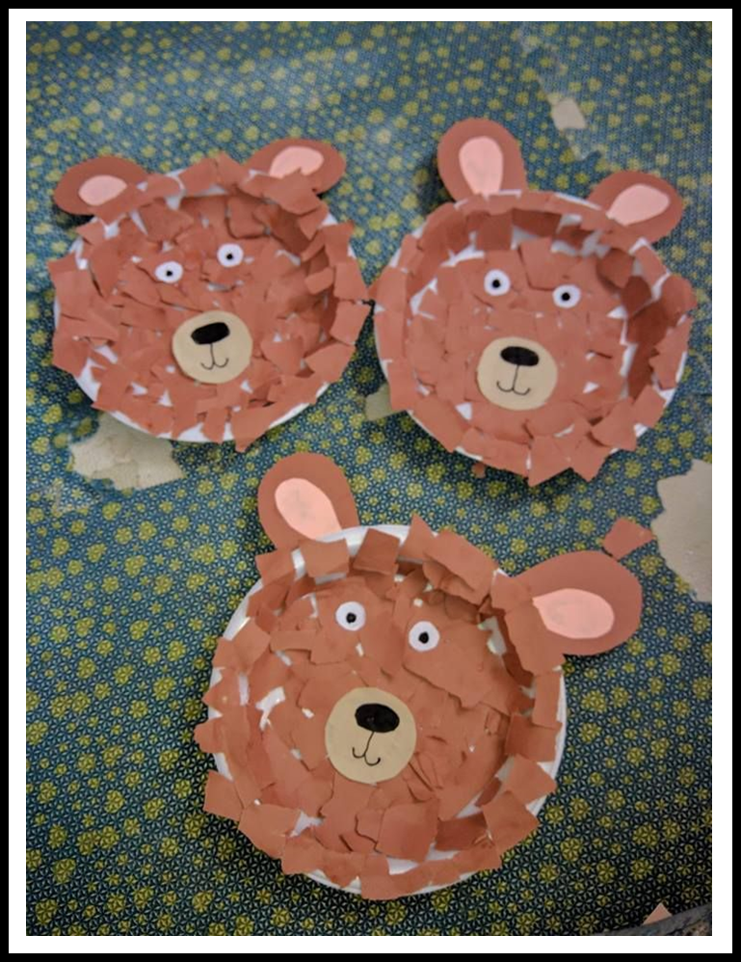
Paper Plate Collage Bears
Items required:
Paper plate
Dark brown paper
Pink paper
Light brown paper
Black marker
Glue stick
Get creative and make your very own brown bear face using the paper plates. To extend the activity, you can use your left over recycling materials and build the bear a body!

Slide 10
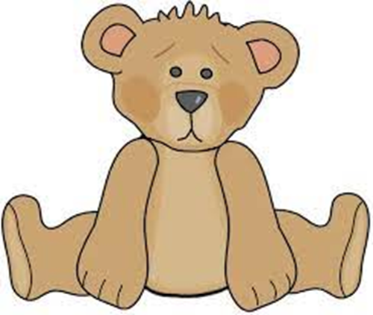
Baby Bears New Chair
Baby Bear is feeling sad after Goldilocks broke his chair.
Can you be a friendly fox and draw baby bear a new chair to help make him happy again?
(You could even try to make the chair out of recycled materials such as cereal boxes and cardboard tubes.)
What will the new chair be made of?
I wonder what colour it will be.
What will it feel like to sit on?
How do think baby bear will feel when he sees the new chair?

Slide 11
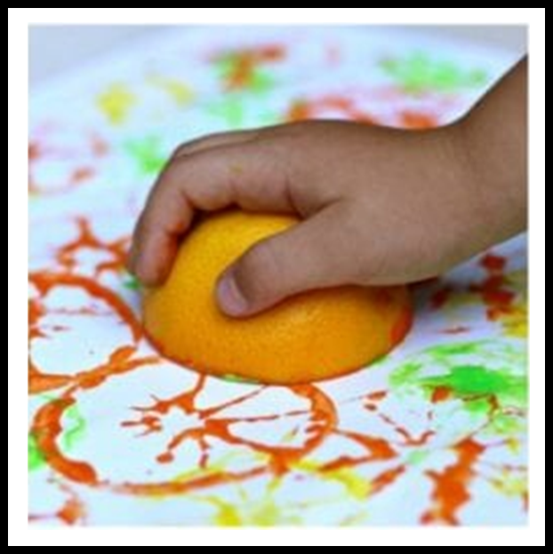
Citrus Fruit Printing
Resources
Oranges, lemons or limes cut into halves
Different coloured paints
Old Tray or plates for the paints
Paper
Method:
Pour some different coloured paints into the trays. The picture above shows the colours of the fruits being used but you could use any colours you have.
Now give your child the freedom to explore the patterns they make from printing with the fruits.
You could also use a pale coloured fabric e.g. an old bedsheet for your child to print on.
See what other items you at home which make an interesting pattern when printed with.

Slide 12
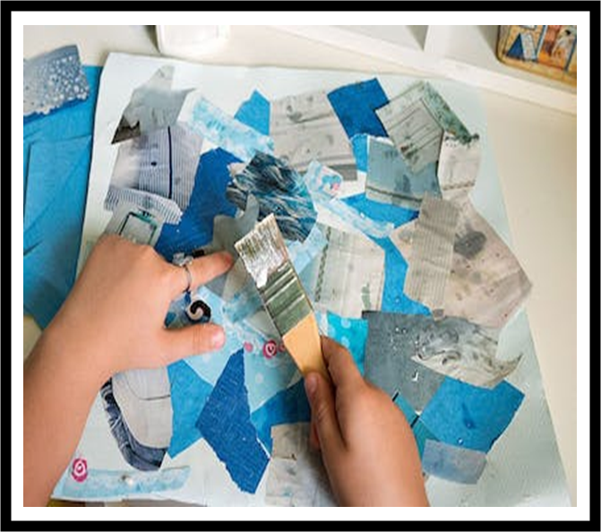
Collage
Resources
Old magazines
Fabric
Wallpaper
Ribbon
Bottle tops
Straws
Scissors
Glue
Paper to stick onto
A brush or glue spreader
If you have children’s scissors, allow your child to cut out pictures and text from the magazines.
If you don’t they may be able to rip them which will give some interesting shapes.
If you don’t have glue you can easily make some with flour and water.
Allow your child the freedom to be creative and decide where to stick each piece You can provide any bits you find around the home to add their collage.
You can make this more challenging by providing a stronger base e.g. a piece of cardboard and adding some recycling materials to stick e.g. toilet roll tubes, boxes silver foil dishes etc
Think about making a natural collage. Go on a hunt to look for different shaped and coloured leaves, sticks, pine cones, acorns etc and produce a collage with them.

Slide 13
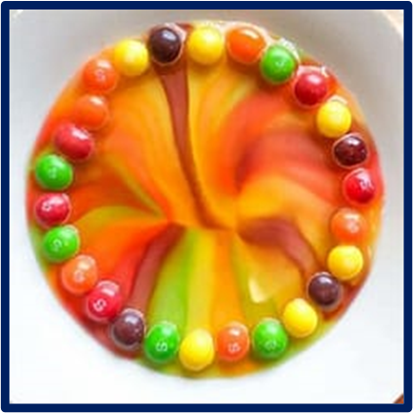
Skittles Rainbow Experiment
Resources
A bag of skittles
Some warm water
A plate
Instructions
Arrange your skittles around the edge of a plate
Gently pour some warm water into the centre of the plate until the bottom of the plate is completely covered.
Wait and watch! The colours will start to spread to the middle and create a rainbow pattern in a matter of minutes!

Slide 14
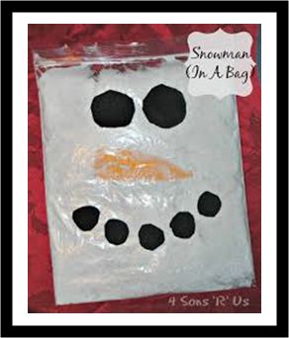
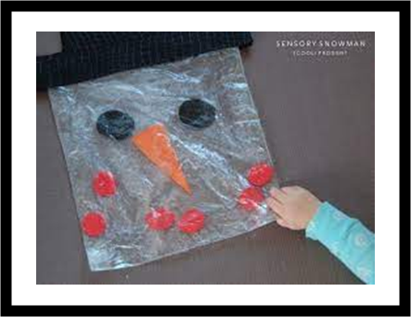
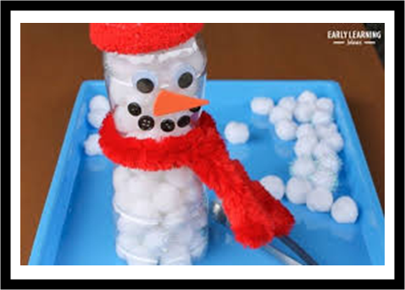
Snowman Activity Play for our children with Additional needs
TEACCH Activity
Can you post the cotton wool balls into the snowman?
Decorate the bottle adding features of a snowman.
Support your child to post cotton wool balls into the top of the bottle.
You could try using some tongs to pick up the cotton wool balls.
Snowman Sensory Play
How to make a sensory bag snowman:
1.Make a snowman face either on or in the bag. You can draw directly onto the bag using pens or alternatively you can place materials into the bag for your child to manipulate when playing with the sensory bag. Materials you could use can include cotton wool balls, bottle tops, stones and even a real carrot for a nose.
2.Once the face is complete place your chosen sensory ingredient into the clear sealable bag. You could use shaving foam, baby oil, hair gel or flour mixed with water.
3.Ensure the bag is sealed, you could use tape to secure it then support your child to explore this sensory experience.
What you will need:
• Empty plastic bottle
• Cotton wool balls
• Felt tip pens to draw the face

Slide 15
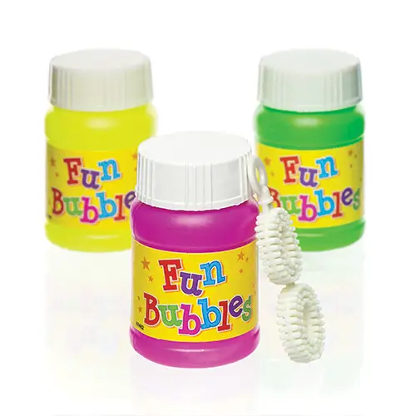
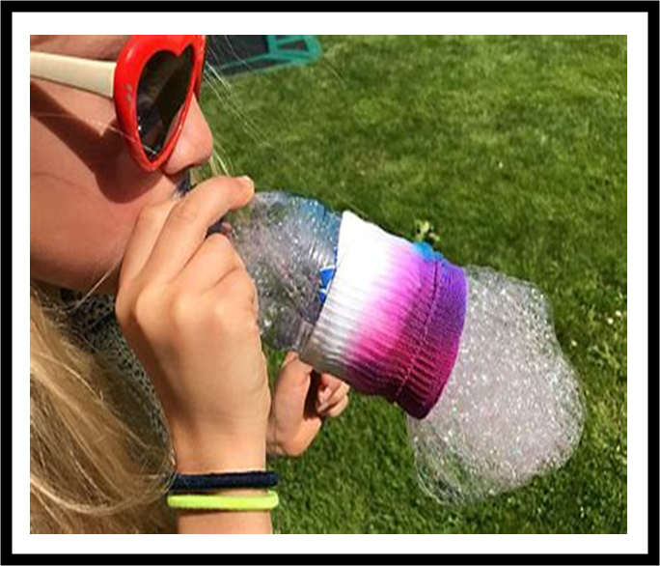
An easy experiment you could do.
Resources
A clean plastic drink bottle
A sock
A bowl that the bottom of the bottle will fit into
A small amount of washing up liquid
An elastic band
Some scissors
Your child might also enjoy blowing bubbles.
Instructions
Adult to cut the bottom out from the bottle using a pair of scissors
Pull the sock up over the bottom of the bottle until it is as far as it will go and then fold it back on itself to make it more secure. If it is still loose you can you use the rubber band to hold it in place.
Put a cup full of water into your bowl and add 2 large squirts of washing up liquid.
Dip the end of the bottle and sock into the bubble solution. Then blow on the mouth piece of the bottle to make the bubbles. (You demonstrate first but then let your child explore)

Slide 16
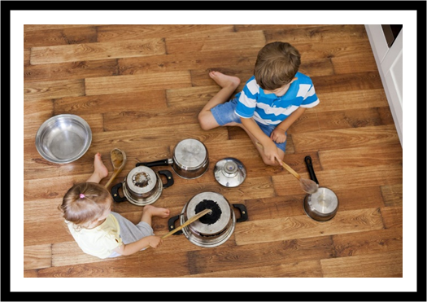
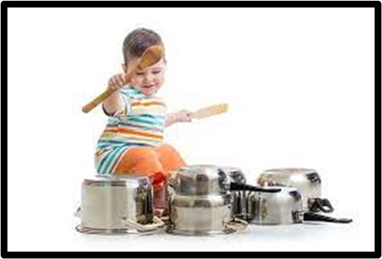
Musical Activity for in your Homes
Music is all around us, we can make music from anything
Get your children to collect a range of different saucepans and metal tins.
Find some wooden spoons, metal spoons and chopsticks.
Let your child create their very own drum set.
Can you make up a rhythm?
Do the pans make different sounds?
Can they drum fast and slow?
Can they follow a beat?

Slide 17
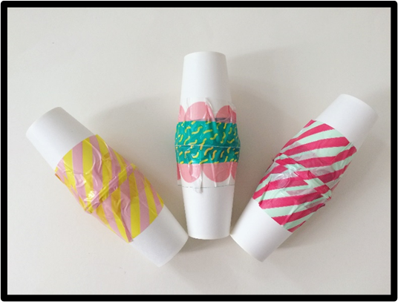
Making Music Shakers
Resources
• Yoghurt pots
• Plastic cups
• Cardboard cups
• Rice
• Dry beans
• Lentils
• Tissue paper
• Elastic band
Method
Let your child choose a clean dry pot
Spoon some rice, dry beans or lentils into the pot
Cover the top of the pot with tissue paper and secure it with an elastic band
Your child should now have a shaker to play
Use a range of different sized pots and different amounts of dry food to create different sounds.

Slide 18
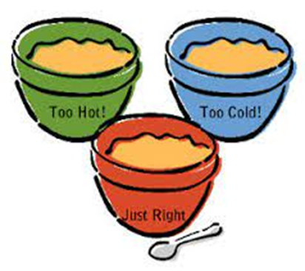
Making Porridge for the Three Bears
We have been looking at the story of goldilocks and the three bears in our class. As part of the story goldilocks tries three different types of porridge
Daddy’s porridge is too hot
Mummy’s porridge is too cold
Baby bears porridge is just right
As a simple mixing activity make the 3 bears of porridge for the bears
Resources
• 3 different sized bowls/spoons
• A mixing bowl
• A mixing spoon
• Porridge oats
• Water
Get the child to pour porridge oats into the mixing bowl. Add a little water into the mixing bowl.
Add a little amount of water to make a dry hard porridge for daddy bear and put it in the large bowl.
Add more porridge to the mixing bowl. This time add lots of water to make it too runny.
Put it in the middle sized bowl for mummy bear.
Add more porridge and water to the mixing bowl and make one that would be just right for the baby bear. Put it in the small bowl.
During this activity use lots of maths words, such as big, small, middle sized
Get the children to estimate how much porridge and water each bowl will need.
Talk about the story. How does the child think Daddy bear would like his porridge etc.

Slide 19
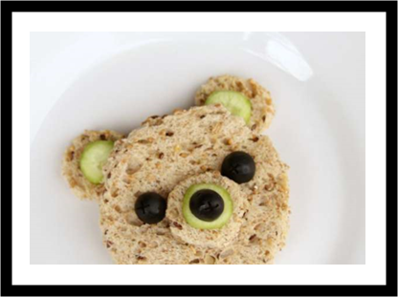
Teddy Bear Sandwiches
Resources
Bread
Butter
Filling to put inside
Spreading knife
Cutting knife
Teddy bear cutter
Method
Let the child get two slices of bread out. Then they can spread the butter on the bread. This is really good for the child’s hand eye coordination and fine motor skills.
Let the child choose what to put inside. If it was jam let them spread it, if it was cheese let them grate it. Put the 2nd slice of bread on top to create a sandwich.
Use your teddy bear cutter to create a teddy bear sandwich.

